Slide 1
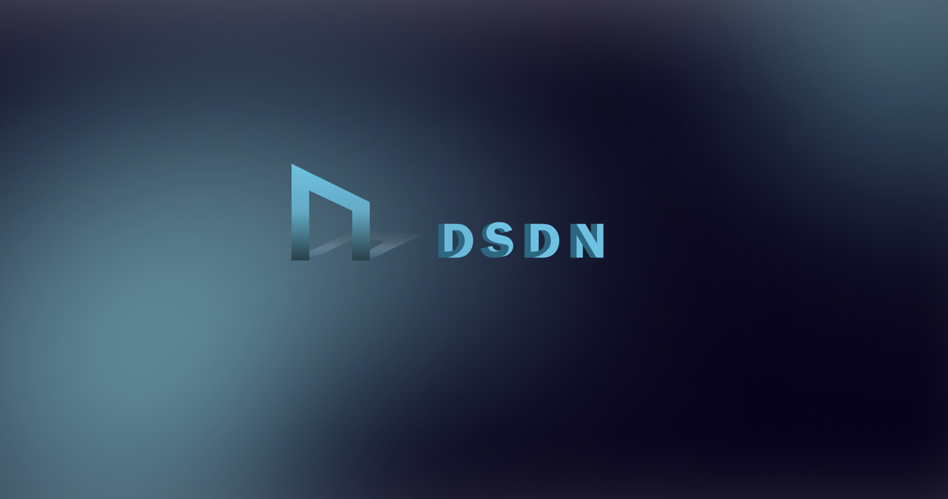

Slide 2

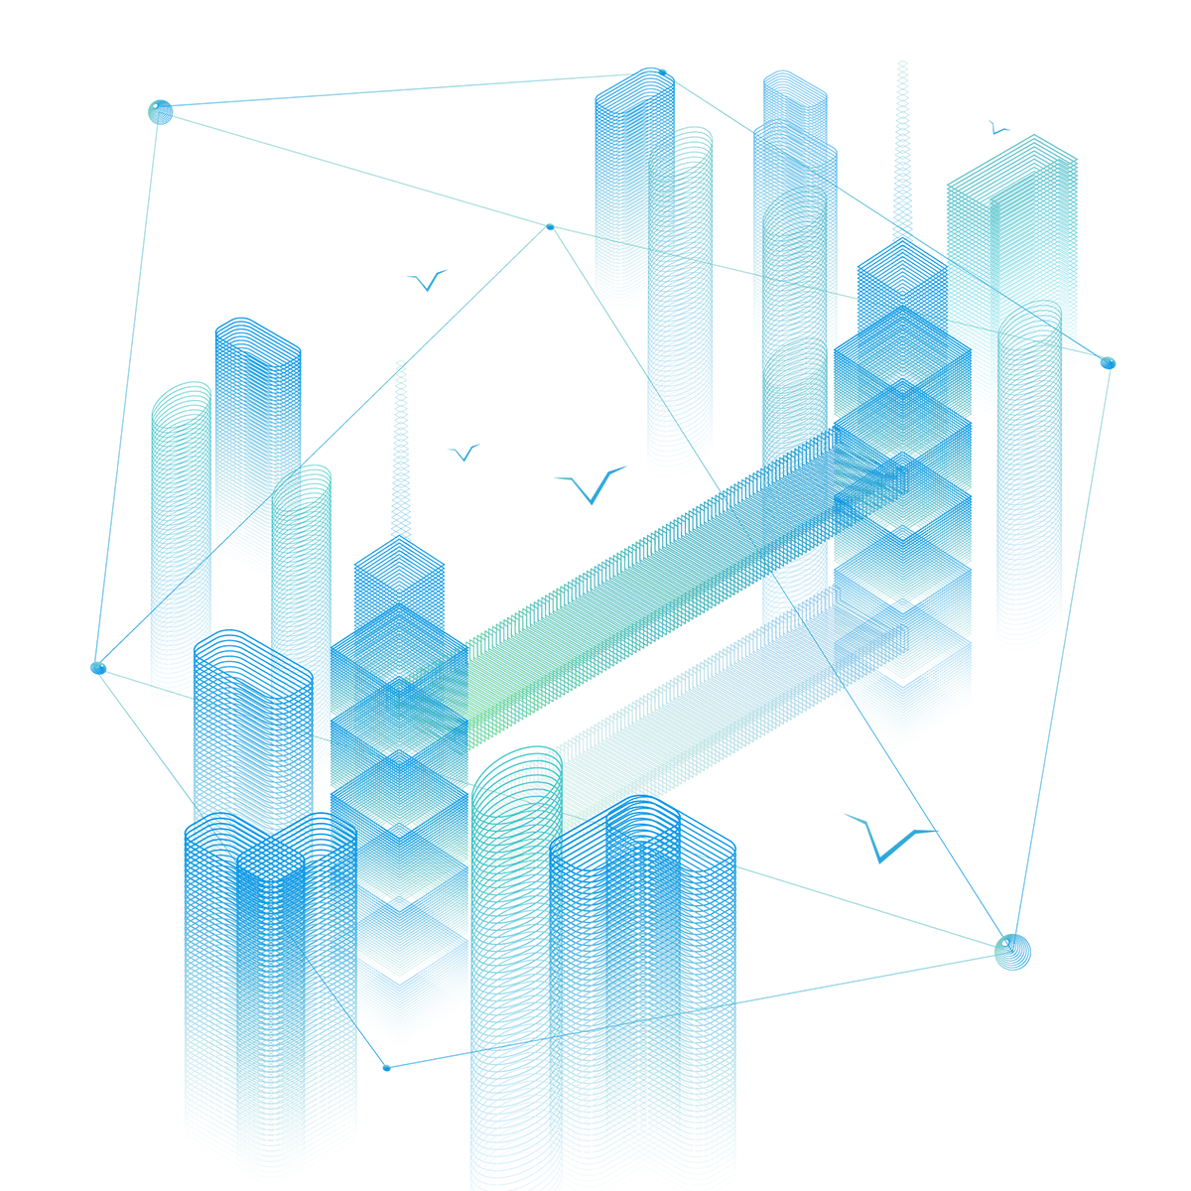



Introduction
Team : One Piece
Product：DSDN（Decentralized Software Developer Network)
Description:
A social DApp that uses NFT as a carrier to carry members’ valuable data like code snippets for depositing and sharing. We embed an achievement system counting members’ contribution by their posts, which would be listed on a honor board. And the branch is a community building metavese based on achievement system, the contribution of metaverse building would also be counted to support DSDN DAO. So the DAO would be in the charge of members who participates deeply in our community, laying the foundation for subsequent community management, resource utilisation and further development.

Slide 3
BackGround
In Web 2.0, your data has value, but it doesn't belong to you, and the value is not shared with you.
Data in the chain is a gold mine, the more applications, the more data, the bigger the gold mine.
In Web 3.0, your valuable actions will eventually be given back, and the carrier of value is your data, which also belongs to you.

Slide 4
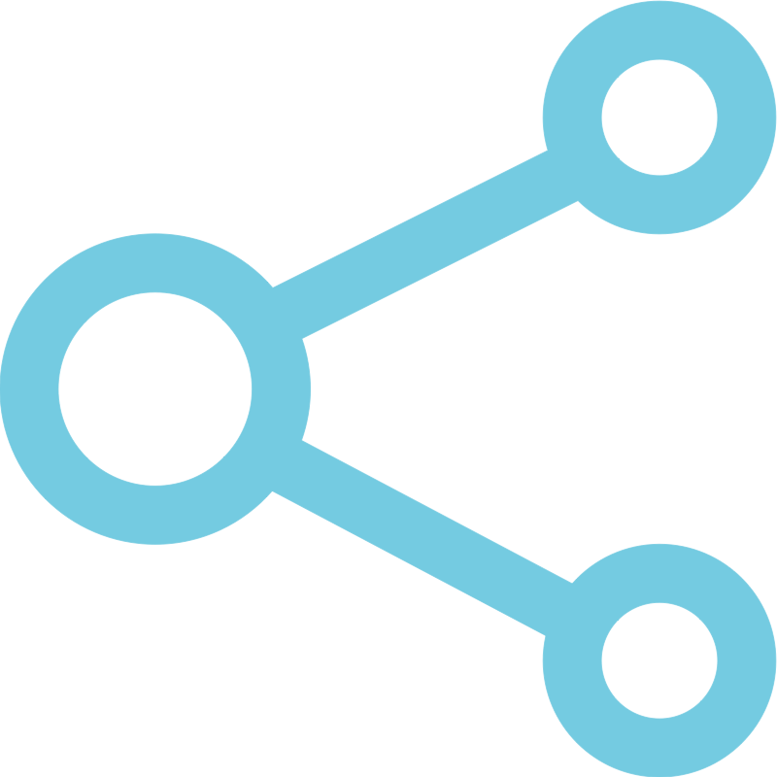
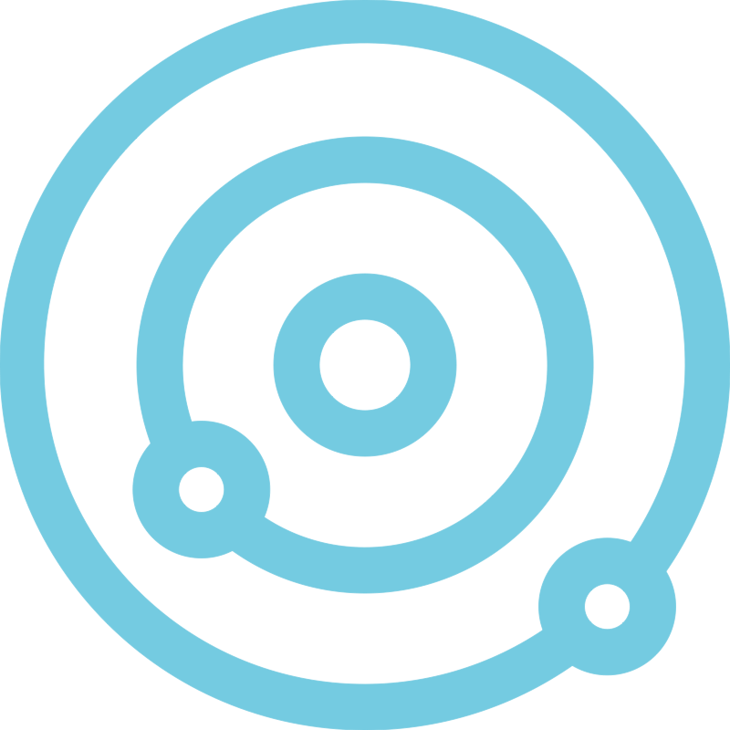

Framework Design
Web3 Social Media
Metaverse
DAO

Slide 5
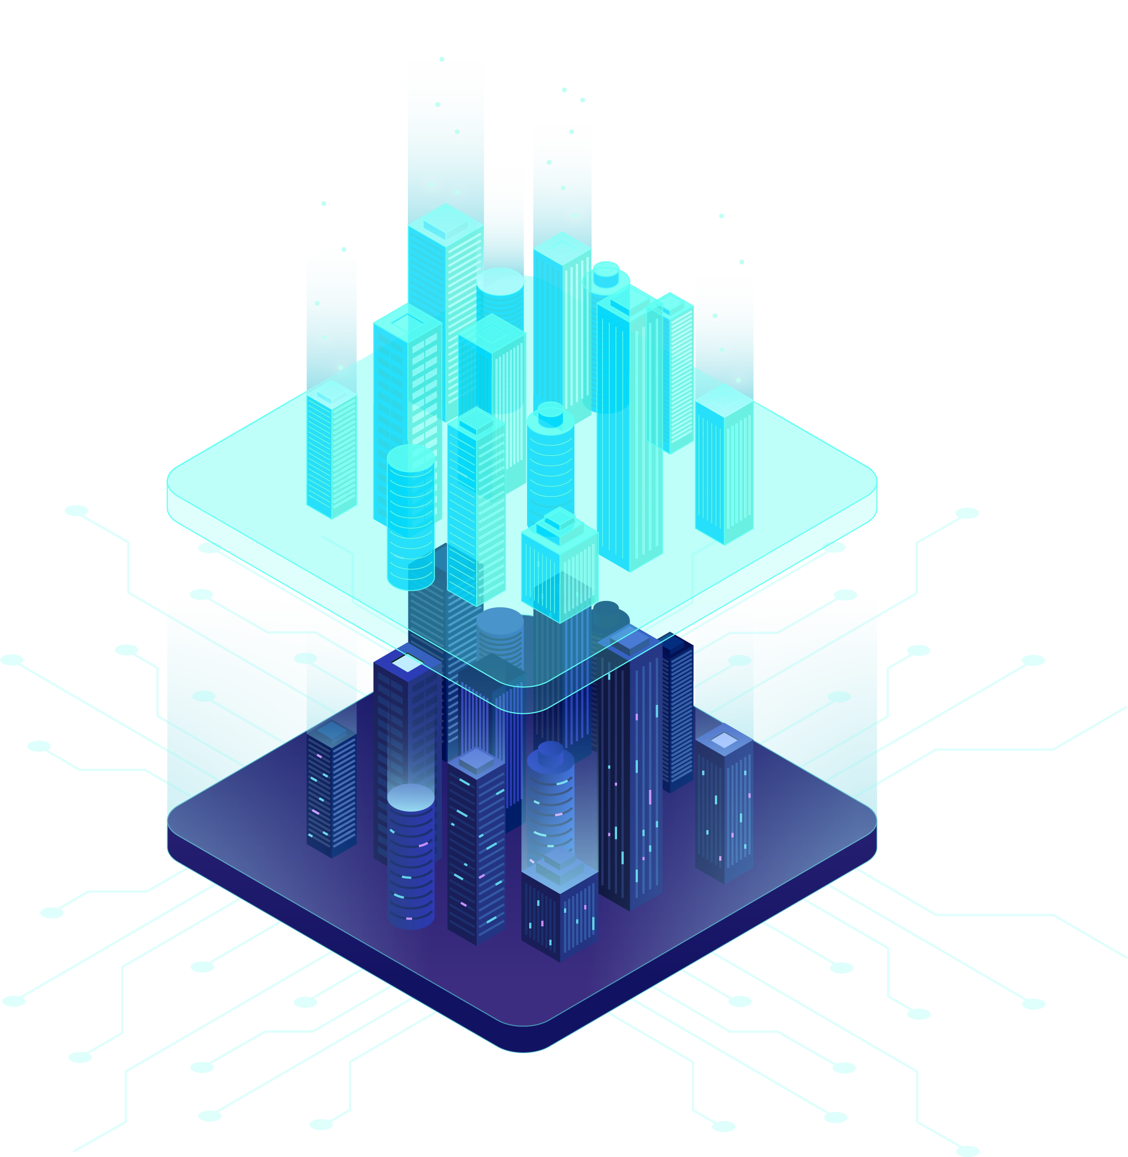
Product Description
The NFTs are stored on IPFS and could be regarded as a experience certification of participating in some project. And posts could be shared and circluated among members in our community, which would be counted as achievements and listed on honor board.
Members will get honor metal that could be displayed on account page. The achievement could be collected to exchange construction meterial to build community metaverse. The metaverse is a special space builded by members, which looks like “Minecraft” in some degree.
DSDN DAO is the organization consisting of members who make contributions to community and participates in deeply construction of metaverse.

Slide 6
